Slide 1
Virtual Trackball
Ed Angel
Professor of Computer Science, Electrical and Computer Engineering, and Media Arts
University of New Mexico
Angel: Interactive Computer Graphics 5E © Addison-Wesley 2009

Slide 2
Objectives
This is an optional lecture that
  Introduces the use of graphical (virtual) devices that can be created using OpenGL
  Makes use of transformations
  Leads to reusable code that will be helpful later
Angel: Interactive Computer Graphics 5E © Addison-Wesley 2009

Slide 3
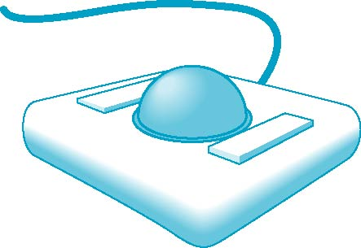
Physical Trackball
The trackball is an “upside down” mouse
If there is little friction between the ball and the rollers, we can give the ball a push and it will keep rolling yielding continuous changes
Two possible modes of operation
  Continuous pushing or tracking hand motion
  Spinning
Angel: Interactive Computer Graphics 5E © Addison-Wesley 2009

Slide 4
A Trackball from a Mouse
Problem: we want to get the two behavior modes from a mouse
We would also like the mouse to emulate a frictionless (ideal) trackball
Solve in two steps
  Map trackball position to mouse position
  Use GLUT to obtain the proper modes
Angel: Interactive Computer Graphics 5E © Addison-Wesley 2009

Slide 5
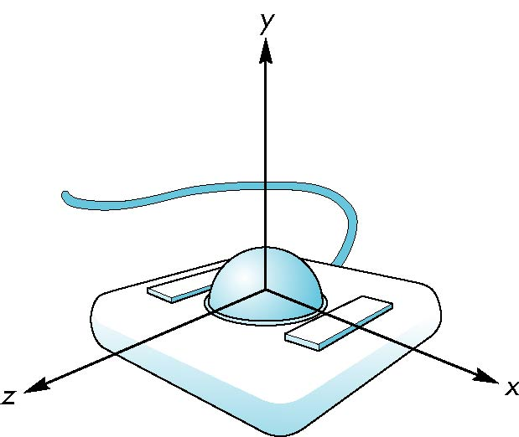
Trackball Frame
origin at center of ball
Angel: Interactive Computer Graphics 5E © Addison-Wesley 2009

Slide 6
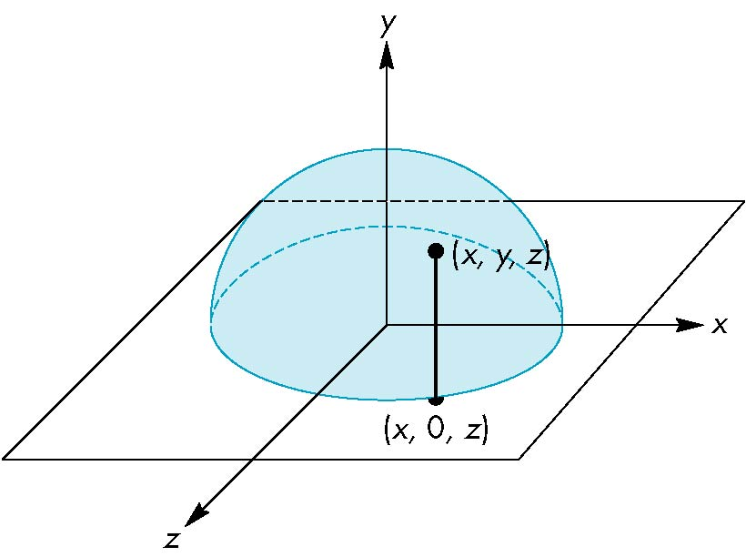
Projection of Trackball Position
We can relate position on trackball to position on a normalized mouse pad by projecting orthogonally onto pad
Angel: Interactive Computer Graphics 5E © Addison-Wesley 2009

Slide 7
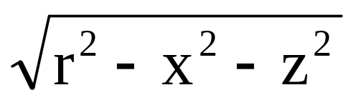
Reversing Projection
Because both the pad and the upper hemisphere of the ball are two-dimensional surfaces, we can reverse the projection
A point (x,z) on the mouse pad corresponds to the point (x,y,z) on the upper hemisphere where
y =
if r ≥ |x|≥ 0, r ≥ |z| ≥ 0
Angel: Interactive Computer Graphics 5E © Addison-Wesley 2009

Slide 8
Computing Rotations
Suppose that we have two points that were obtained from the mouse.
We can project them up to the hemisphere to points p₁ and p₂
These points determine a great circle on the sphere
We can rotate from p₁ to p₂ by finding the proper axis of rotation and the angle between the points
Angel: Interactive Computer Graphics 5E © Addison-Wesley 2009

Slide 9
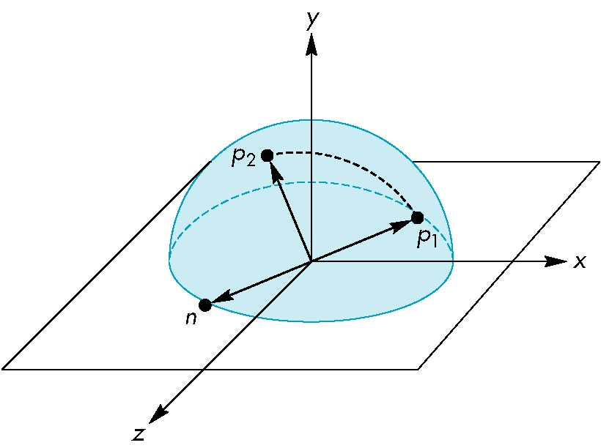
Using the cross product
The axis of rotation is given by the normal to the plane determined by the origin, p₁ , and p₂
n = p₁ × p₂
Angel: Interactive Computer Graphics 5E © Addison-Wesley 2009

Slide 10
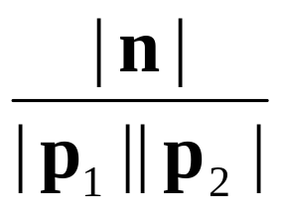
Obtaining the angle
The angle between p₁ and p₂ is given by
If we move the mouse slowly or sample its position frequently, then θ will be small and we can use the approximation
| sin θ| =
sin θ ≈ θ
Angel: Interactive Computer Graphics 5E © Addison-Wesley 2009

Slide 11
Implementing with GLUT
We will use the idle, motion, and mouse callbacks to implement the virtual trackball
Define actions in terms of three booleans
trackingMouse: if true update trackball position
redrawContinue: if true, idle function posts a redisplay
trackballMove: if true, update rotation matrix
Angel: Interactive Computer Graphics 5E © Addison-Wesley 2009

Slide 12
Example
In this example, we use the virtual trackball to rotate the color cube we modeled earlier
The code for the colorcube function is omitted because it is unchanged from the earlier examples
Angel: Interactive Computer Graphics 5E © Addison-Wesley 2009

Slide 13
Initialization
#define bool int /* if system does not support
bool type */
#define false 0
#define true 1
#define M_PI 3.14159 /* if not in math.h */
int winWidth, winHeight;
float angle = 0.0, axis[3], trans[3];
bool trackingMouse = false;
bool redrawContinue = false;
bool trackballMove = false;
float lastPos[3] = {0.0, 0.0, 0.0};
int curx, cury;
int startX, startY;
Angel: Interactive Computer Graphics 5E © Addison-Wesley 2009

Slide 14
The Projection Step
voidtrackball_ptov(int x, int y, int width, int height, float v[3]){
float d, a;
/* project x,y onto a hemisphere centered within width, height , note z is up here*/
v[0] = (2.0*x - width) / width;
v[1] = (height - 2.0F*y) / height;
d = sqrt(v[0]*v[0] + v[1]*v[1]);
v[2] = cos((M_PI/2.0) * ((d < 1.0) ? d : 1.0));
a = 1.0 / sqrt(v[0]*v[0] + v[1]*v[1] + v[2]*v[2]);
v[0] *= a; v[1] *= a; v[2] *= a;
}
Angel: Interactive Computer Graphics 5E © Addison-Wesley 2009

Slide 15
glutMotionFunc (1)
void mouseMotion(int x, int y)
{
float curPos[3],
dx, dy, dz;
/* compute position on hemisphere */
trackball_ptov(x, y, winWidth, winHeight, curPos);
if(trackingMouse)
{
/* compute the change in position
on the hemisphere */
dx = curPos[0] - lastPos[0];
dy = curPos[1] - lastPos[1];
dz = curPos[2] - lastPos[2];
Angel: Interactive Computer Graphics 5E © Addison-Wesley 2009

Slide 16
glutMotionFunc (2)
if (dx || dy || dz)
{
/* compute theta and cross product */
angle = 90.0 * sqrt(dx*dx + dy*dy + dz*dz);
axis[0] = lastPos[1]*curPos[2] –
lastPos[2]*curPos[1];
axis[1] = lastPos[2]*curPos[0] –
lastPos[0]*curPos[2];
axis[2] = lastPos[0]*curPos[1] –
lastPos[1]*curPos[0];
/* update position */
lastPos[0] = curPos[0];
lastPos[1] = curPos[1];
lastPos[2] = curPos[2];
}
}
glutPostRedisplay();
}
Angel: Interactive Computer Graphics 5E © Addison-Wesley 2009

Slide 17
Idle and Display Callbacks
void spinCube()
{
if (redrawContinue) glutPostRedisplay();
}
void display()
{ glClear(GL_COLOR_BUFFER_BIT|GL_DEPTH_BUFFER_BIT);
if (trackballMove)
{
glRotatef(angle, axis[0], axis[1], axis[2]);
}
colorcube();
glutSwapBuffers();
}
Angel: Interactive Computer Graphics 5E © Addison-Wesley 2009

Slide 18
Mouse Callback
void mouseButton(int button, int state, int x, int y)
{
if(button==GLUT_RIGHT_BUTTON) exit(0);
/* holding down left button
allows user to rotate cube */
if(button==GLUT_LEFT_BUTTON) switch(state)
{
case GLUT_DOWN:
y=winHeight-y;
startMotion( x,y);
break;
case GLUT_UP:
stopMotion( x,y);
break;
}
}
Angel: Interactive Computer Graphics 5E © Addison-Wesley 2009

Slide 19
Start Function
void startMotion(int x, int y)
{
trackingMouse = true;
redrawContinue = false;
startX = x;
startY = y;
curx = x;
cury = y;
trackball_ptov(x, y, winWidth, winHeight, lastPos);
trackballMove=true;
}
Angel: Interactive Computer Graphics 5E © Addison-Wesley 2009

Slide 20
Stop Function
void stopMotion(int x, int y)
{
trackingMouse = false;
/* check if position has changed */
if (startX != x || startY != y)
redrawContinue = true;
else
{
angle = 0.0;
redrawContinue = false;
trackballMove = false;
}
}
Angel: Interactive Computer Graphics 5E © Addison-Wesley 2009

Slide 21
Quaternions
Because the rotations are on the surface of a sphere, quaternions provide an interesting and more efficient way to implement the trackball
See code in some of the standard demos included with Mesa
Angel: Interactive Computer Graphics 5E © Addison-Wesley 2009

